Slide 1

Sentiment Analysis
Shubham Kumar (2015UGEC038)
Rahul Nag (2015UGEC060)
Saurabh Kumar Bharti (2015UGEC068)
16th November, 2018

Slide 2
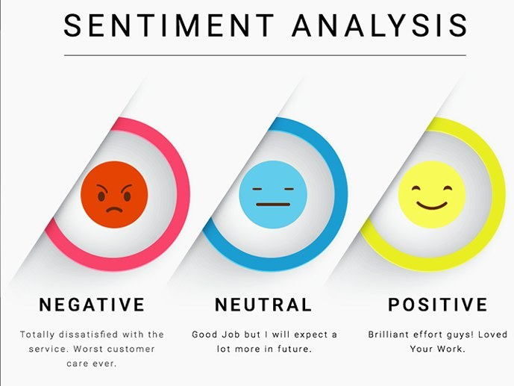
Aim: To determine whether a tweet is positive, negative or neutral.
What is Sentiment Analysis?
Process of ‘computationally’ determining whether a piece of writing is positive, negative or neutral.
Also known as opinion mining, deriving the opinion or attitude of a speaker.

Slide 3
Uses of Sentiment Analysis
Business:
Development of market strategies.
Used to understand customers’ feelings towards products or brand.
Politics:
Used to keep track of political view, to detect consistency and inconsistency between statements and actions at the government level.
Used to predict election results as well.
Public Actions:
Used to monitor and analyse social phenomena, for the spotting of potentially dangerous situations.
Used to determine the general mood of the blogosphere.

Slide 4
Illustrative application areas for Sentiment analysis
Entertainment
Electronics
Books
Health and Food
Travel
Personal Finance
Online Services
Malls and Stores
Fashion

Slide 5
Project Overview
Sentimental analysis over the required hashtags or queries and generation of overall sentiment score
To show the tweets on which the sentiment analysis has taken place
User Interface

Slide 6



Tools and Softwares Used
Software Used: Spyder 3.3.0
Python Libraries Used:
Tweepy: tweepy is the python client for the official Twitter API.
TextBlob: textblob is the python library for processing textual data.

Slide 7
Authentication
In order to fetch tweets through Twitter API, one needs to register an App through their twitter account. Follow these steps for the same:
Open https://apps.twitter.com and click the button: ‘Create New App’ .
Fill the application details.
Once the app is created, you will be redirected to the app page.
Open the ‘Keys and Access Tokens’ tab.
Copy ‘Consumer Key’, ‘Consumer Secret’, ‘Access token’ and ‘Access Token Secret’.

Slide 8
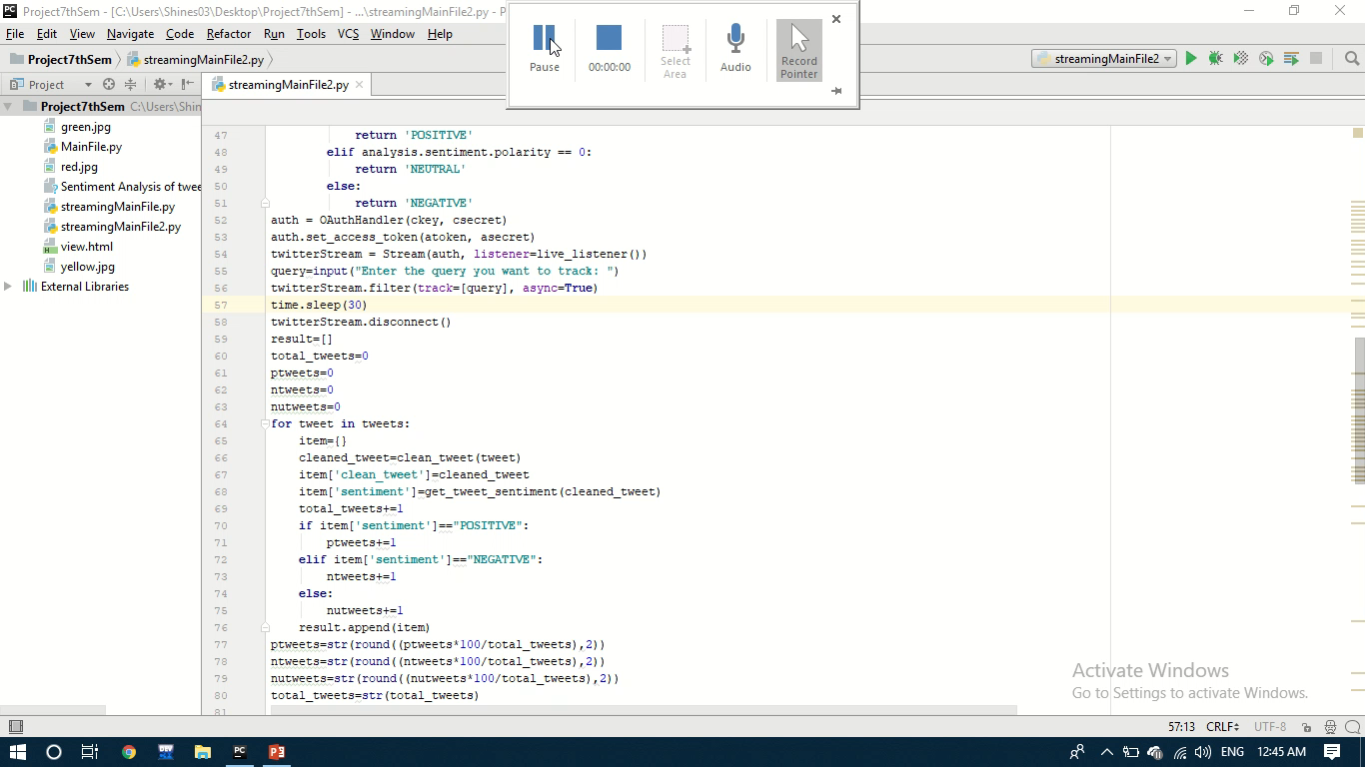
Implementation and User Interface

Slide 9
Thank you for your valuable time

